Slide 1
Final Year Project Roll # B21120206053 Financial Computer Simulation (FM 617) BS Financial Mathematics (4th Year)
Submitted to Sir Daniyal Hussain
Submitted by:
Wania Iqbal

Slide 2
CODING METHODOLOGY
Data Generation & Acquisition
Preprocessing Steps
Modeling Techniques
Evaluation Metrics
Visualization

Slide 3
DATA GENERATION & ACQUISITION
Stock Prices
with downtrend and high volatility.
Credit Risk
with income, loan, credit score, and employment type.
Revenue/Expense
data with growth trends and seasonality.

Slide 4
PREPROCESSING STEPS
Handled missing values using:
Forward-fill and backfill for time series.
Median/mode imputation for tabular data.
Encoded categorical variables using Label Encoder and one-hot encoding.
Created new features:
Moving averages (SMA_10)
Log returns and rolling volatility (for stock data)
Previous values for regression.

Slide 5
Stock Forecasting: Linear Regression ARIMA for time series Credit Risk Modeling: Logistic Regression Decision Tree Classifier Revenue/Expense Forecasting: Linear Regression Random Forest Regressor Gradient Boosting Regressor Stochastic Processes & Derivatives: Simulated using Geometric Brownian Motion Option pricing with Black-Scholes and Binomial Tree
Modeling Techniques:

Slide 6
Evaluation Metrics
Regression:
RMSE, MAE, R² Score
Classification:
Accuracy, Precision, Recall, F1-score, Confusion Matrix

Slide 7
Visualization
Plots for actual vs. predicted values
Confusion matrices for classification
Heat maps, histograms, time series line plots

Slide 8
FINANCIAL INTERPRETATION
Stock Price Models
Credit Risk Models
Revenue/Expense Forecasting
Derivatives Pricing

Slide 9
STOCK PRICE MODELS
Linear Regression:
had moderate predictive ability
RMSE = 2.29, MAE = 1.48, R² = 0.37
ARIMA :was less accurate on test data
RMSE = 3.13, R² = -0.18 (indicating poor generalization)
Interpretation:
The stock exhibits high volatility; linear regression captures some patterns, but ARIMA’s negative R² suggests it fails to generalize well.

Slide 10
CREDIT RISK MODELS
Logistic Regression
Precision = 1.0 (all predicted positives were correct) Recall = 0.06 (missed most of the actual positives)
Decision Tree:
Balanced performance: Accuracy = 56.67%, F1 = 0.6061💳
Interpretation:
Logistic regression is overly conservative. The decision tree offers a more balanced assessment of risk.

Slide 11
REVENUE/EXPENSE FORECASTING:
Best model for revenue:
Linear Regression (R² = 0.54)
Best model for expense:
Linear Regression (R² = 0.44)
Interpretation:
Revenue and expenses show seasonal and linear growth trends, best captured by linear regression over tree-based models.

Slide 12
DERIVATIVES PRICING:
Call Option
(S=100, K=100, T=1, σ=0.25, r=0.02)
Binomial Tree ≈ \$10.85
Black-Scholes ≈ \$10.87
Put Option: \~\$8.87
Interpretation:
Binomial and Black-Scholes models yield consistent option prices, validating the stochastic model.

Slide 13
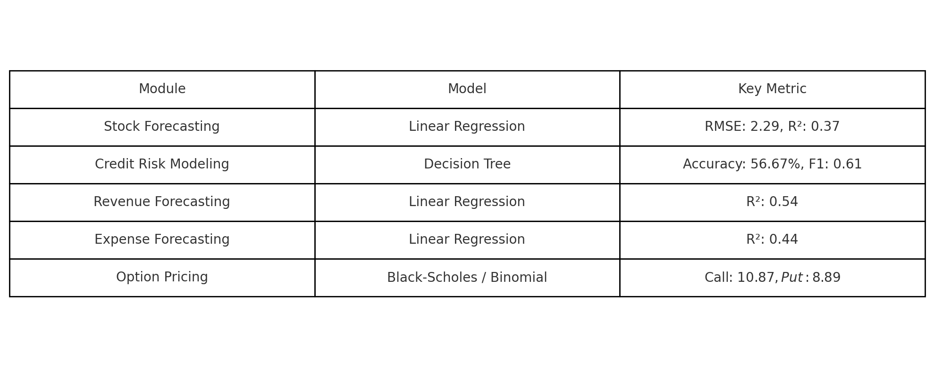
Result Submission Summary

